Slide 1
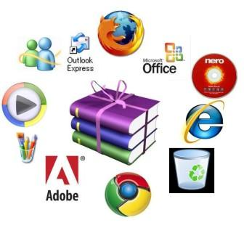
Computer Software
Objective 2.02: Understand computer performance and features

Slide 2
Essential Question:
What are the functions and components of operating systems and programs?

Slide 3
Computer Components: Software
Software – the instructions that tell the computer what to do; programs of the computer system

Slide 4
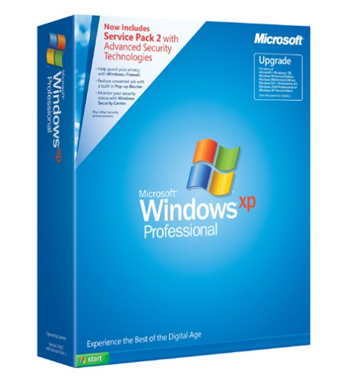
System Software
Also known as the operating system (OS)
Sets the rules for how the hardware and software work together
Controls the operations of the computer system
Booting (starting up) the computer
Files stored on the hard drive
Examples:
Windows (2000, XP, Vista)
Mac
Linux

Slide 5
Application Software
Software that works with the operating system to meet a specific need or perform a specific task
Examples:
MS Word
MS Excel
MS PowerPoint
MicroType
Internet Explorer

Slide 6
Types of Application Software
Word Processing - allows you to create, edit, and print text documents
Letters
Reports
Spreadsheet – used to organize information and perform calculations
Electronic gradebook
Electronic checkbook
Database – allows you to create an electronic filing system
Electronic card catalog
Electronic address book

